Slide 1
Classical Machine Learning
Model Evaluation Metrics
Week 4 - Day 3

Slide 2
SECTION 1: CLASSIFICATION METRICS
Why Evaluation Metrics Matter?
Key Ideas:
Not all metrics work for all tasks.
Choose the metric based on:
Task type (classification or regression)
Dataset balance
Business goal (false positives vs false negatives)

Slide 3
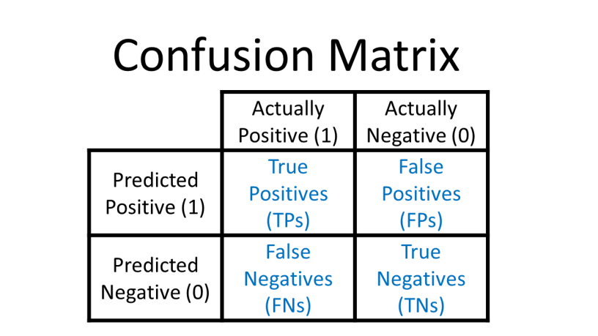
Confusion Matrix – The Core of Classification
Why It Matters:
All classification metrics are derived from these 4 values.

Slide 4
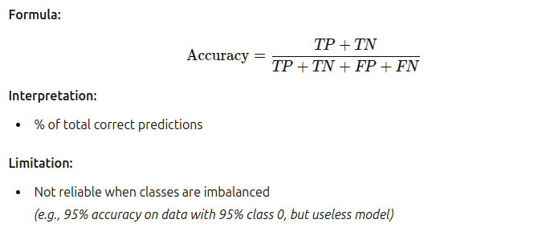
Accuracy – Basic but Limited

Slide 5
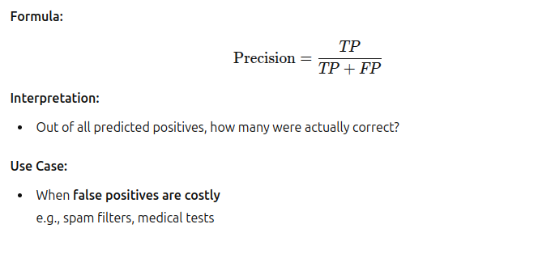
Precision – Focus on Positives You Predicted

Slide 6
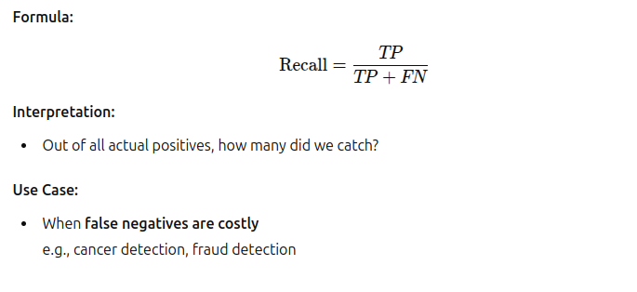
Recall – How Many Actual Positives Did We Find?

Slide 7
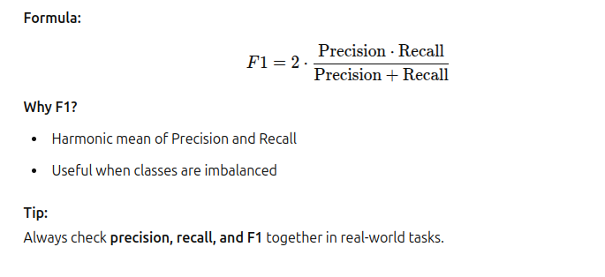
F1 Score – Balance Between Precision & Recall

Slide 8
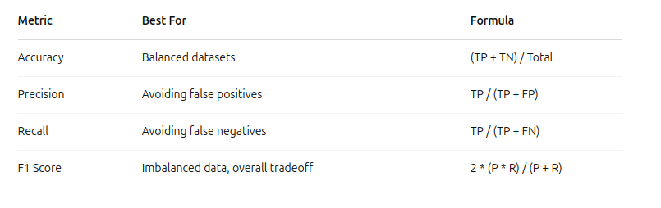
Summary – Classification Metrics Table

Slide 9
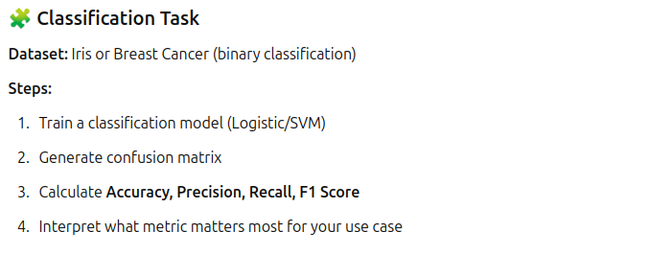
Activity

Slide 10
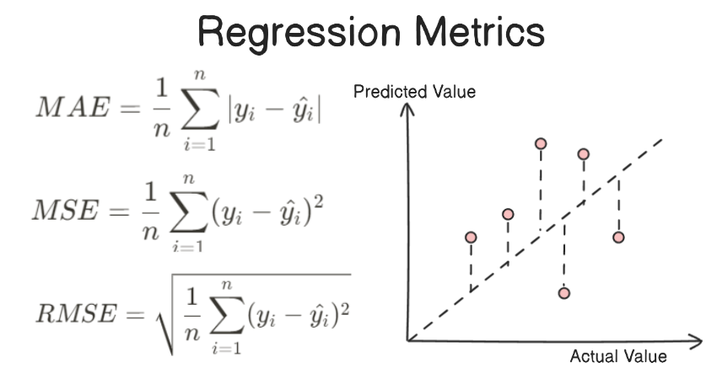
SECTION 2: REGRESSION METRICS
Goal of Regression:
Predict continuous numeric values
Challenge:
Need to measure how far predictions are from actual values
Approach:
Use error-based metrics (the smaller, the better)

Slide 11
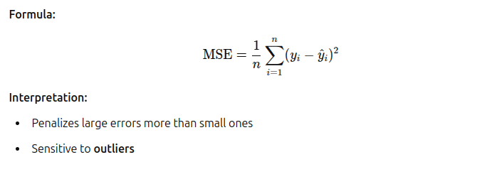
Mean Squared Error (MSE)

Slide 12
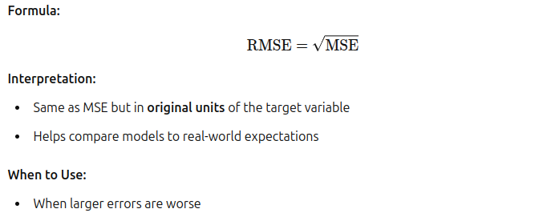
Root Mean Squared Error (RMSE)

Slide 13
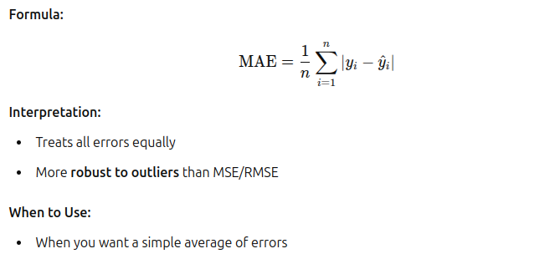
Mean Absolute Error (MAE)

Slide 14
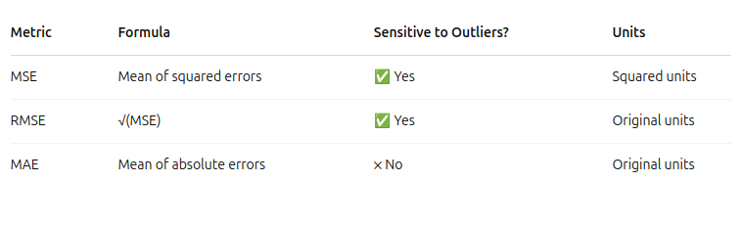
Summary – Regression Metrics Table

Slide 15
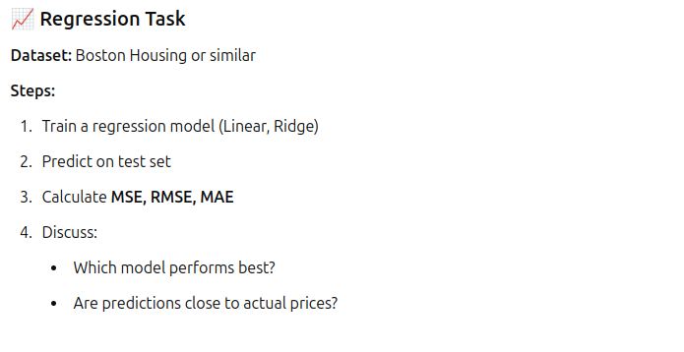
Activity

